Slide 1


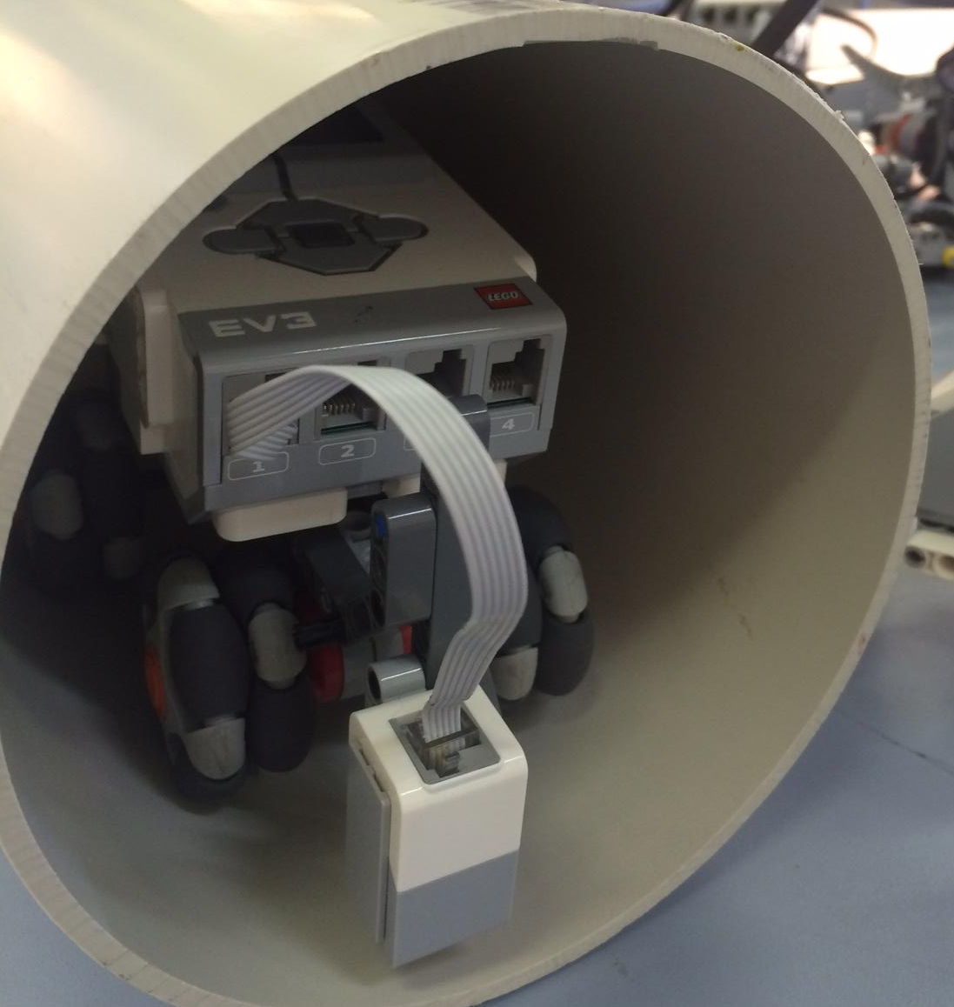
EV3 Pipeline Robot
Neil Gray
Sacred Heart College
Engineering
An exercise in STEM education using EV3 datalogging

Slide 2
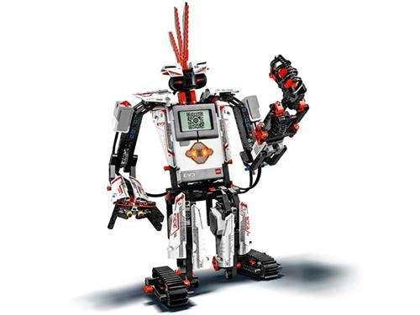
The Challenge
There has been a terrible disaster at a nuclear reactor. The internal monitoring of the reactor has failed and it is way too hazardous to send peiople into the containment vessel to take measurements.
Luckily we can detect problems through measuring the internal temperature of a pipe that travels through the reactor casing.
We are simulating the pipelineusing a 150mm diameter and you will be using the EV3 robots to collect the data you need to produce a map of the internal temperature of the reactor.

Slide 3
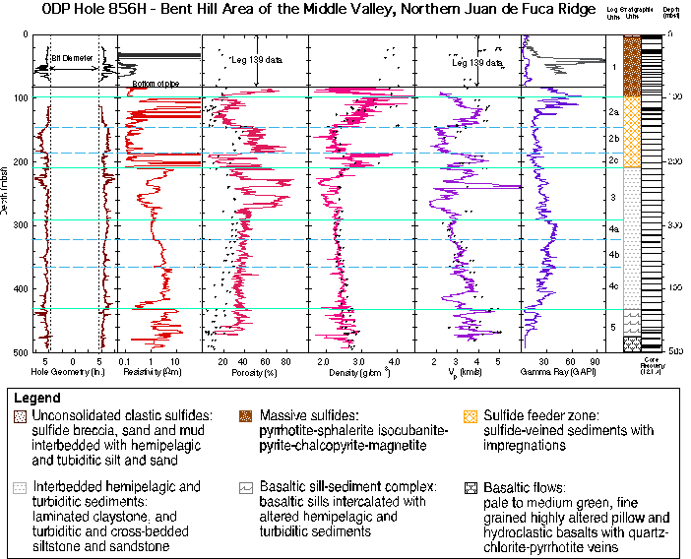
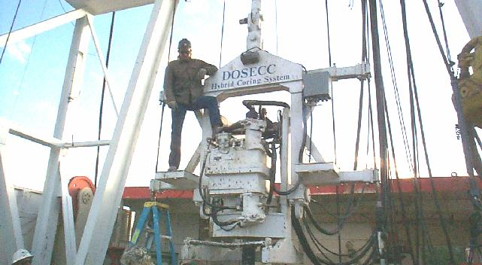
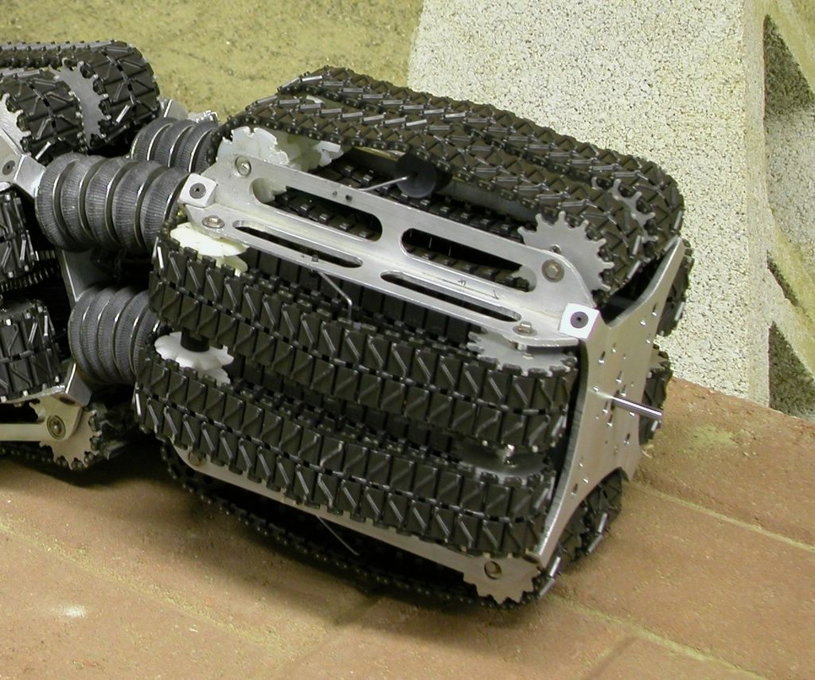
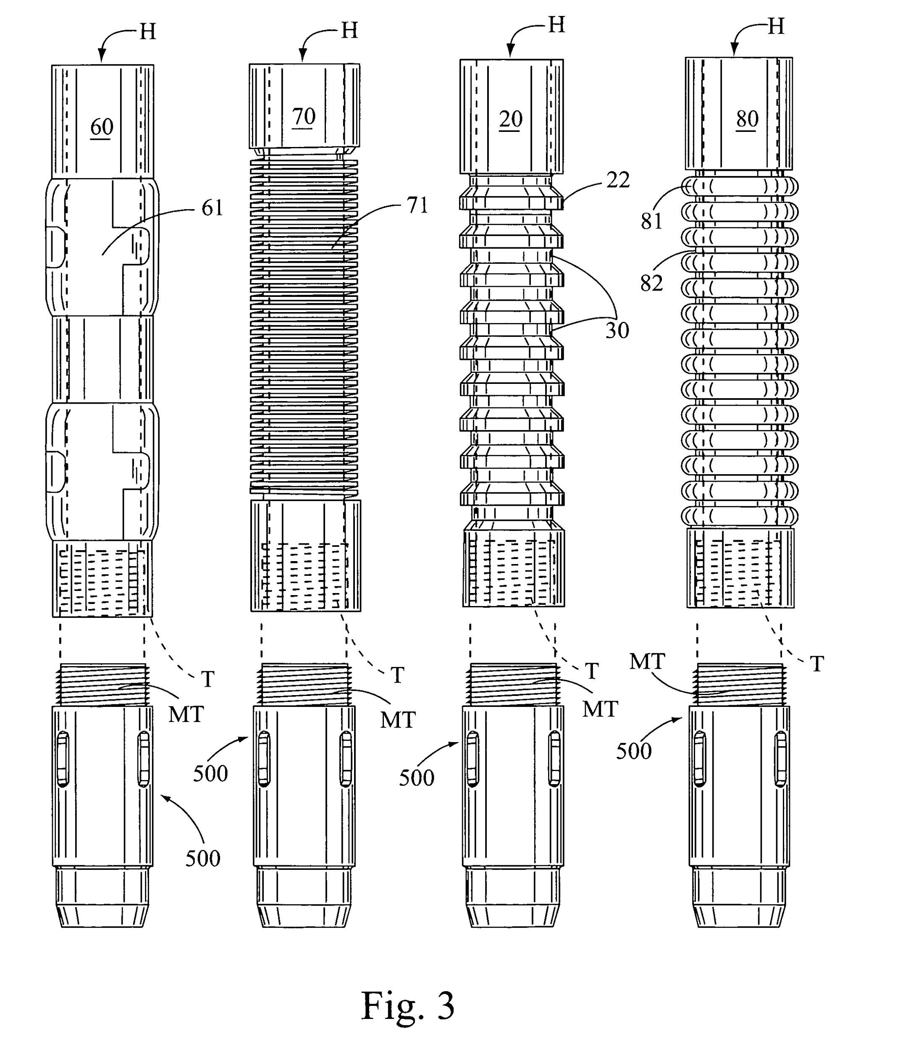
Datalogging

Slide 4

Challenge Part 1 – The Robot
The robot needs to fit into a 150mm diameter pipe
The robot must run straight and true for the length of the pipe
Is steering needed – single motor?
How to mount sensor
  Adjustable fixed locations, multiple runs
  Rotary scanner, single run

Slide 5
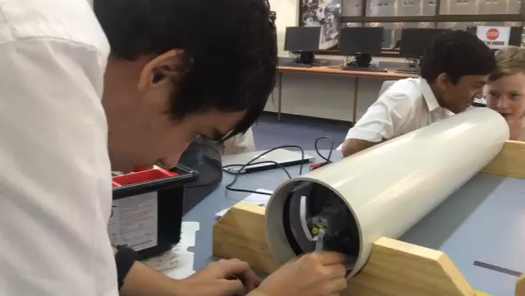
It works !!!!!

Slide 6
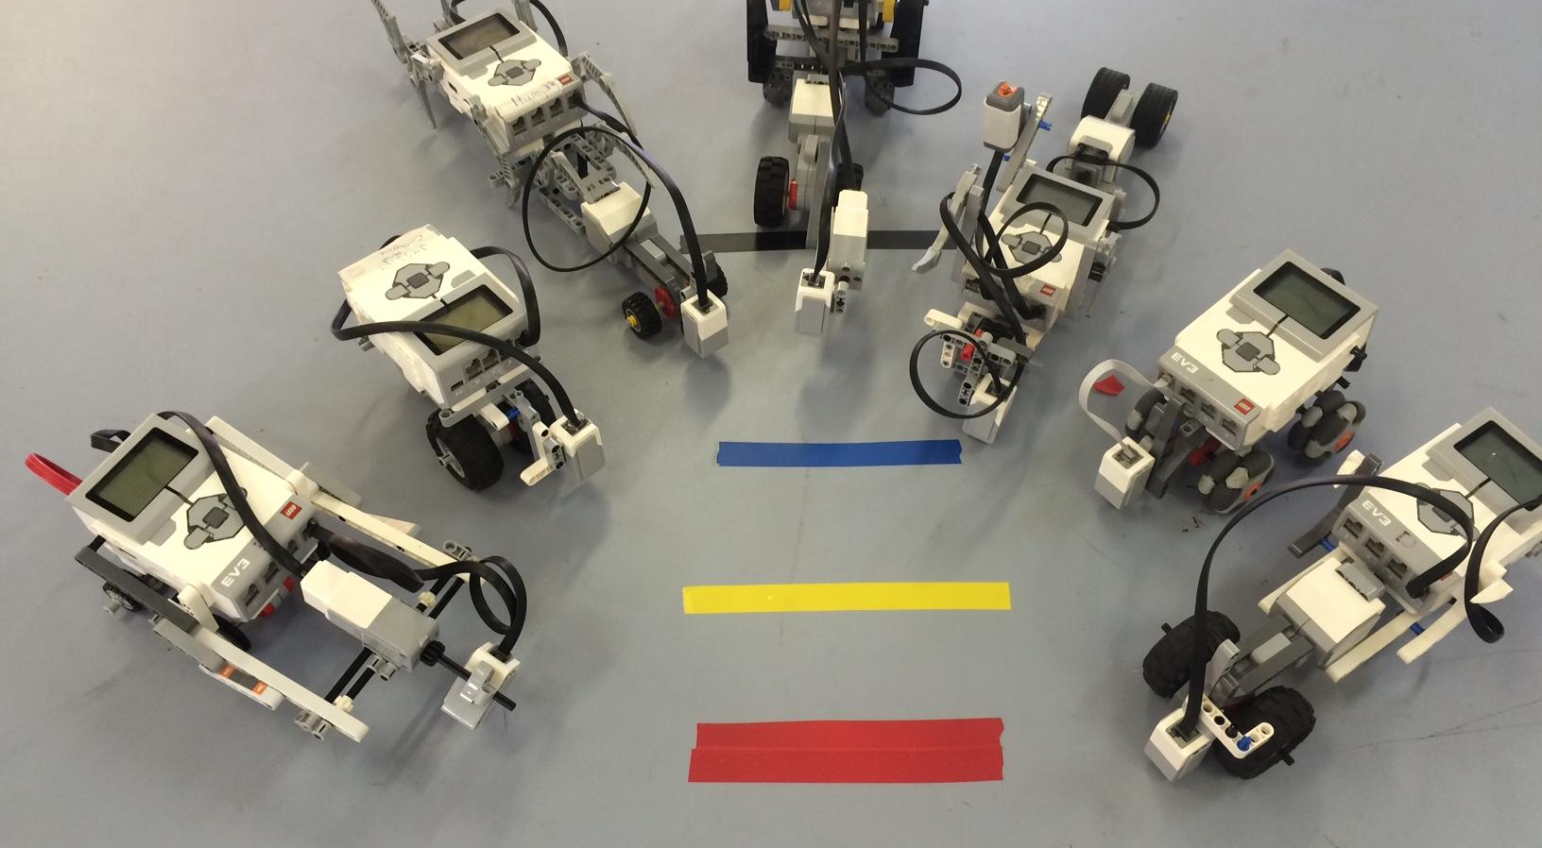
Some ideas …..

Slide 7

Challenge Part 2 - Programming
Detecting Colours
Desktop testing of sensors
Datalogging
Desktop testing of datalogging
Testing in the pipe
Correlation of data

Slide 8

Class Rule - Everyone Codes
Unless your name is Chuck
Note : This is not a current feature of the EV3 software!

Slide 9
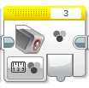
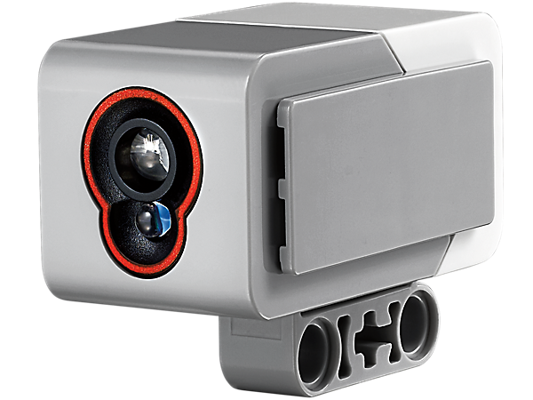


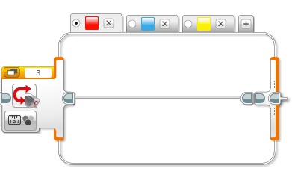
Detecting Colours
Measure colour, reflected light or ambient light
Range of blocks to read values or control program flow

Slide 10
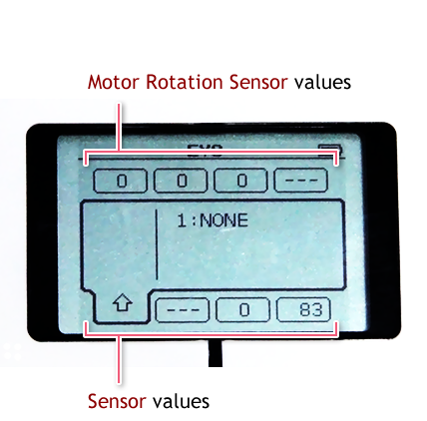
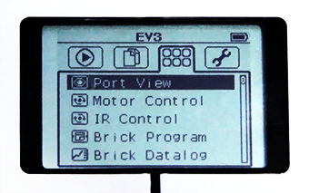
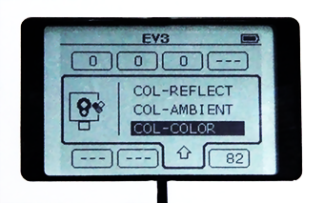
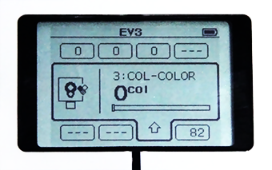
Checking out the sensor
(Using Port View)
1.
2.
Colour Codes
3.
4.

Slide 11
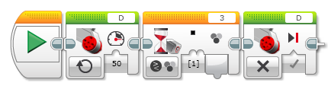
Exercise 1 – Stopping on Colour
Get robot to stop on black.
Motor on (continuous)
Waiting for black (select via tick box)
Stop the motor (what would happen if you left this out?)

Slide 12
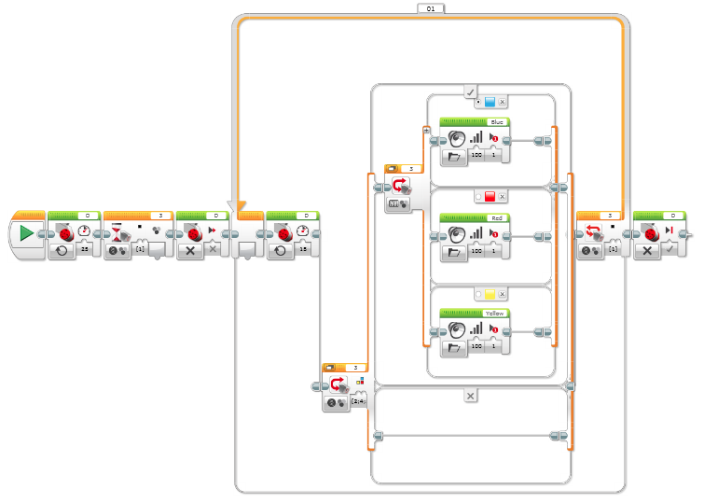
Exercise 2 - Calling it out
Note that we are using two different types of colour Switches. Why?
Calling out if we see one of the colours
This program may not work for your robot.
What is happening if the robot just stops after seeing the black line
The fix is simple – add another block. But which one? And where?
What else could you add to make sure you know what the robot is doing
Looking for second black line and stopping the robot
Do nothing if colours not present, Why is this needed?

Slide 13
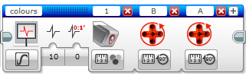
The Data Logging Block
Name of data set
Sensors being logged
Add a new sensor here
Sampling control
Sensor setup
Sampling rate
Type of rate
0=samples per second
1=seconds between sample

Slide 14
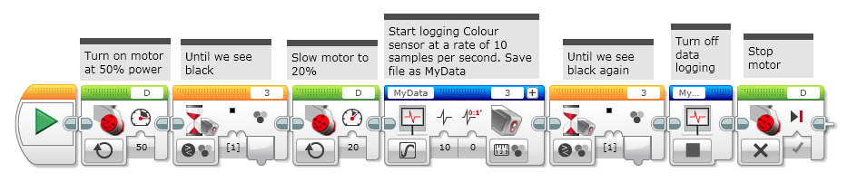
Exercise 3 - Desktop Data Logging
Try out this program
Did you pick up all the colours ?
Modify the program to also log the drive motor rotation

Slide 15
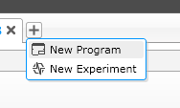

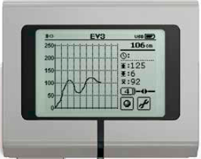
Using the “Oscilloscope”
Start a new Experiment.
Make sure your robot is connected via Bluetooth or USB cable.
Turn on the Oscilloscope function and see what you can monitor
Check out the onboard Brick Datalog function. Cool.

Slide 16
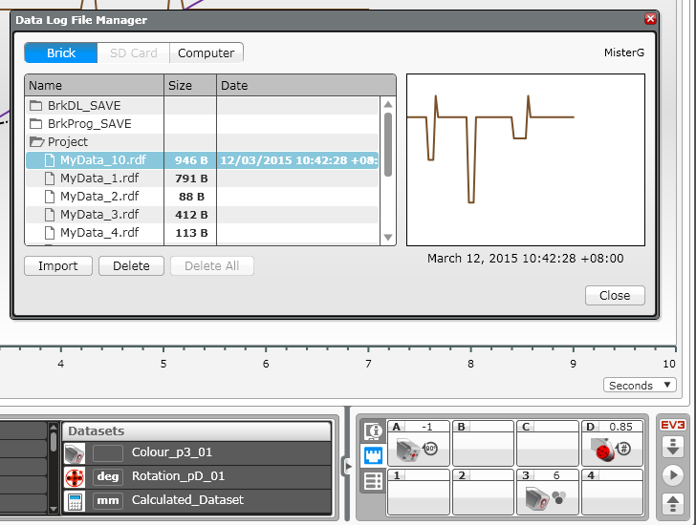
Uploading the data
Source
Files
Preview of data
Select and import
Connect up robot and upload here

Slide 17
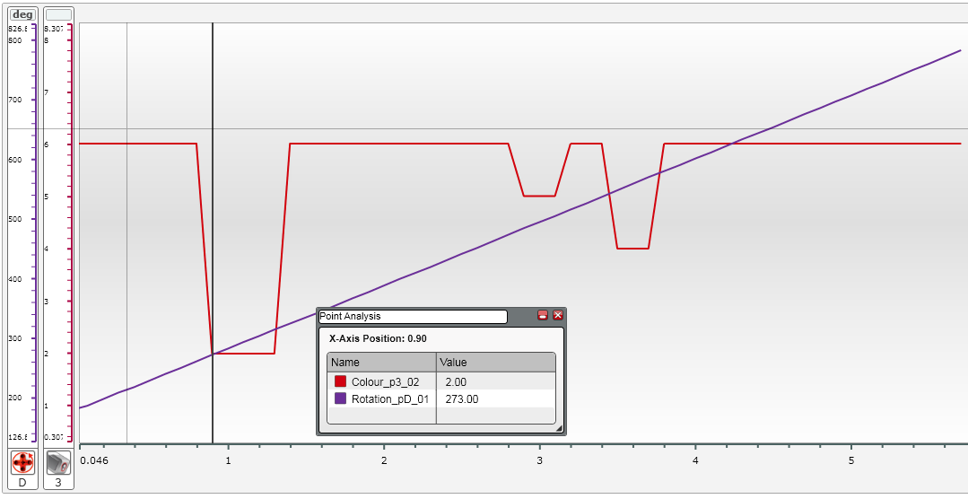
Interpreting the data
Rotations
Colour
Point Analysis
At 0.9 seconds Colour=2 (blue)
Rotations = 273º

Slide 18

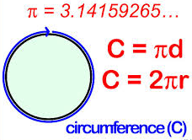

Hmmm ….. π
In one revolution of the wheel the robot travels a distance equal to the Circumference

Slide 19
Doing some maths …
We are measuring the degrees of rotation of the motor
This needs to be converted to linear distance using the circumference equation
C= π X D which equates to one revolution of the wheel
Now, for a 60mm rolling diameter wheel and tyre ….
        C = π X 60
        = 3.14 X 60
        = 188mm
Therefore, for each degree of rotation (360 degrees in a circle)
The robot travels C/360
= 188/360
= 0.52mm / degree

Slide 20
More maths …
Say we record 100 degrees of rotation as our distance …
        D =rotations (degrees) X 0.52
        = 100 X 0.52
        = 52 mm
        Still with me ?
This will hopefully get a little clearer when we see the data
Luckily – we can get the data logging program to do this maths for us !

Slide 21
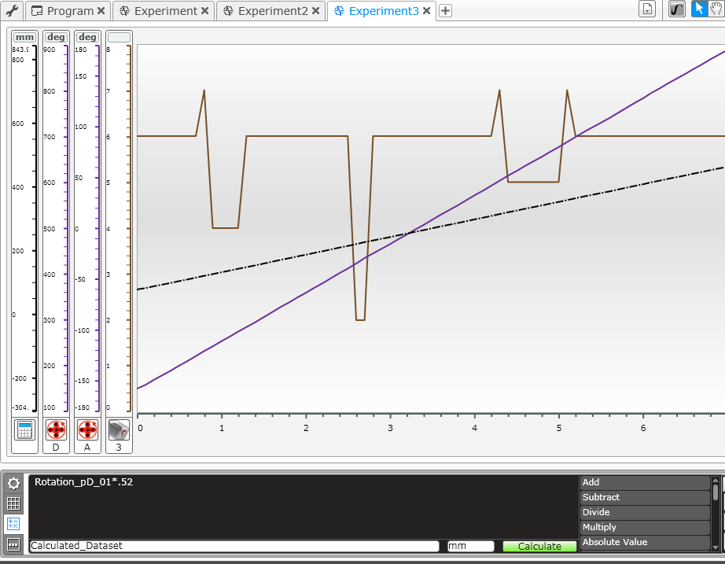
Playing with the data
Set up the Dataset Calculations to convert rotations (degrees) to mm travelled

Slide 22
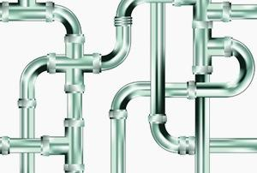
Time for the pipe ….
Your robot needs to travel down the pipe until it senses a black line.
The robot then needs to turn off data logging at some stage and travel out of the pipe.
Hint : Consider adding some feedback in your program so you can know what is happening inside the pipe

Slide 23
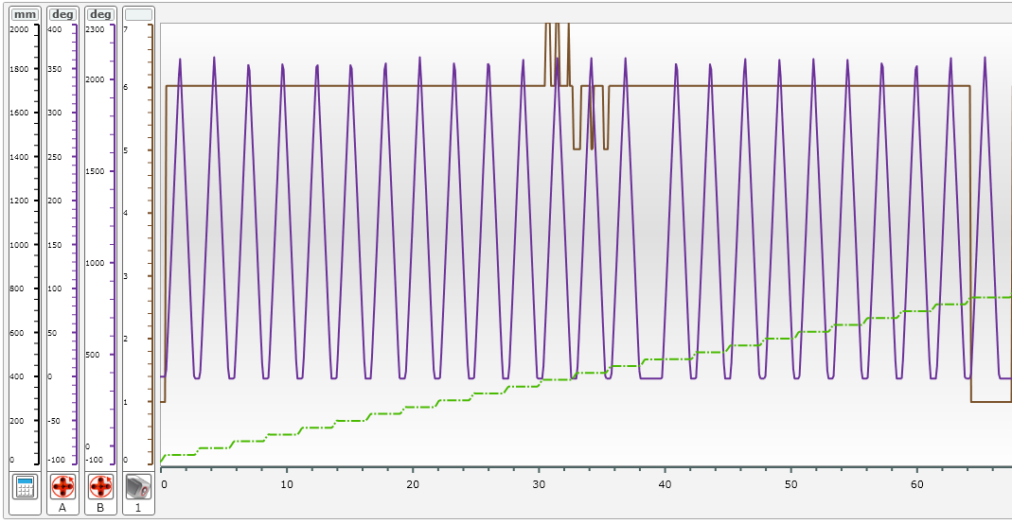
Typical Data set

Slide 24
Making a Map
Degrees of Rotation
Convert degrees rotation to mm

Slide 25

Overall 630mm X 470mm
Each square is 25mm

Slide 26
Overall 630mm X 470mm
Each square is 25mm

Slide 27

